Slide 1
Bellabeat Leaf Product Improvement: Trends and Insights
By Evan Smith
01/30/2023

Slide 2
Examining FitBit Data
Time frame: 30 days
Users/Participants: 33
Users tracked activity time, activity intensity, sleep, weight, and logged activity.
Initial hypothesis: Users would show a lot of activity of an intense nature.
Notes:
What trends were revealed?

Slide 3
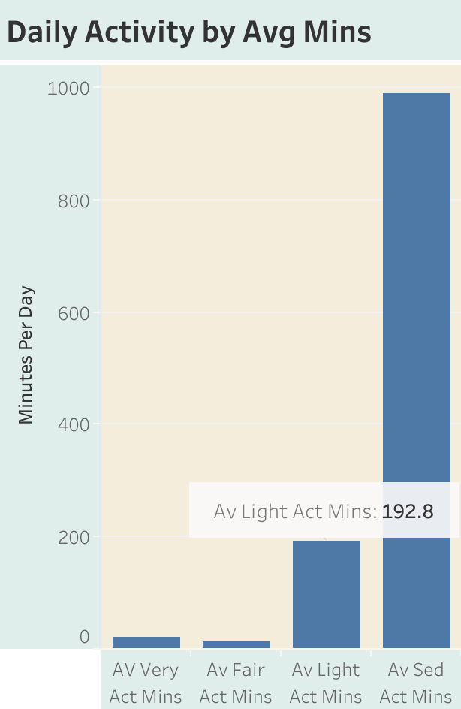
The majority of the minutes spent each day were sedentary.
Users spent around 3 hours a day doing light activity.
Users spent 16 hours doing sedentary activity( this included time spent sleeping)

Slide 4
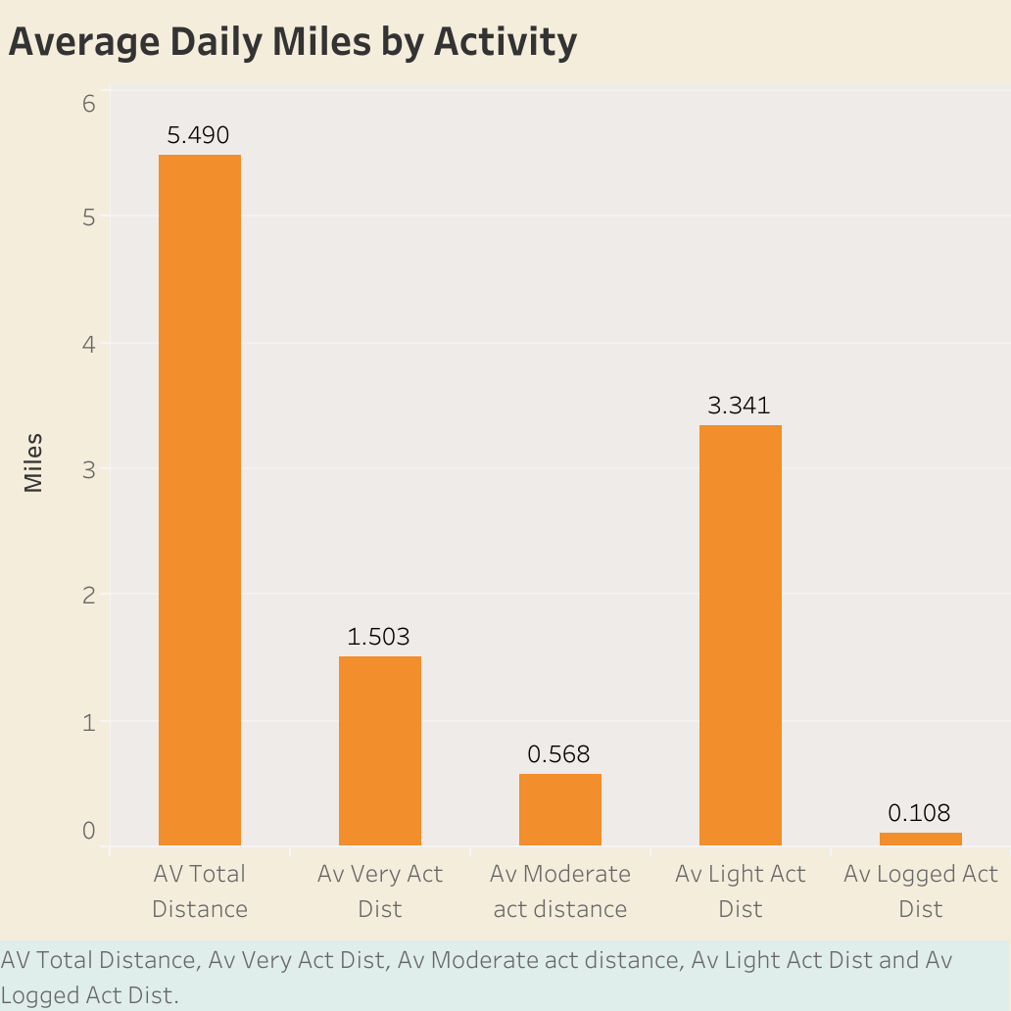
Further cementing our finding about light activity, of the total distance users logged each day, the majority of the distance was light activity.
Users spent very little time logging their activity.

Slide 5
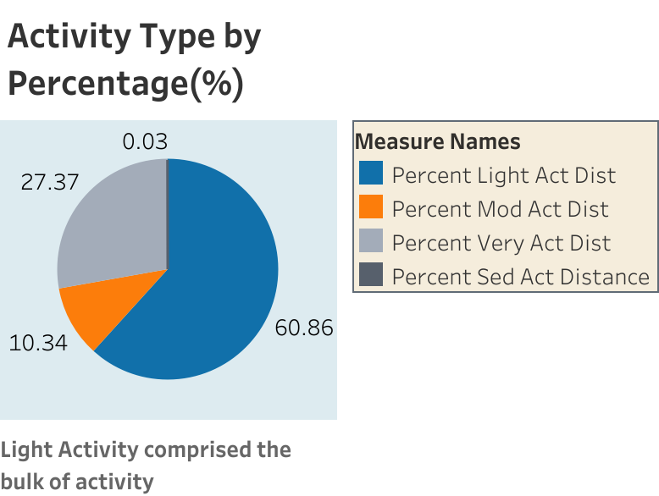
Our initial hypothesis was very wrong. The average FitBit users daily distance was comprised of less than 1/10 of 1% of Very Active activity.

Slide 6
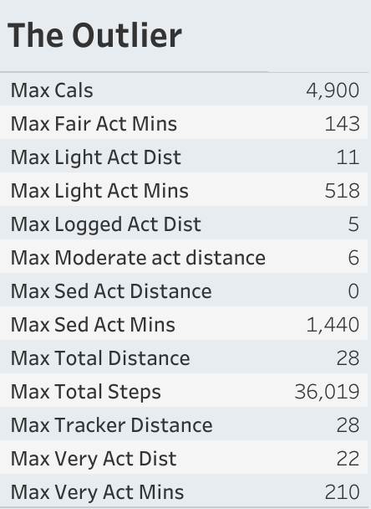
The results were slightly skewed by the outlier. One user clearly ran a marathon (26 miles, 385 yards)

Slide 7
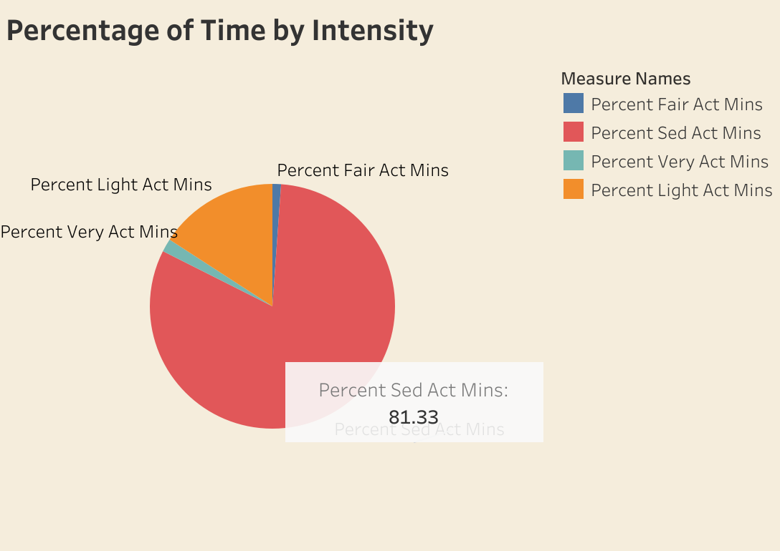
FitBit users live a sedentary lifestyle on average

Slide 8
Main takeaways, data limitations, and Recommendations
Users live a sedentary lifestyle and are not weekend warriors in terms of activity.
Light activity comprised the bulk of activity intensity and time i.e. walking, housework, gardening.
Limitation: User age was not revealed and that is a major factor in activity levels.
Limitation: Towards the end of the period, users stopped tracking their activity.
Recommendations:
To increase activity, send more notifications to get users to move more.
Recommend different types of light activity.
Recommend different intensity activities for users throughout the day.

